Slide 1
How to make an analytics report or DV workbook pre-filter by library per staff user
Yoel Kortick
Senior Librarian

Slide 2

Agenda
Introduction
The staff user role
The sample users
The library-specific filter and the sample analytics report
Seeing the library-specific filter functionality live
Adding the library-specific filter for the prompt
Seeing the library-specific filter for the prompt functionality live
Statistical Categories by Library
Adding the library-specific filter for statistical categories
Seeing the library-specific filter for statistical categories functionality live
Regarding other subject areas
The DV workbook

Slide 3
Introduction

Slide 4
Introduction
This presentation will explain how it is possible to have one analytics report which will filter by different libraries per staff user.
This is useful in institutions where each library in the institution is a completely independent entity and staff users are allowed to see data only from "their own" libraries or certain libraries.

Slide 5
Introduction
For example, user A may be permitted to see only entities in the Science Library, while user B may be permitted to see only entities in the Art Library, and user C may be permitted to see entities in either the Education Library or the Engineering Library.
With this new feature one analytics report can be made and it will automatically filter by a predefined library (or libraries) per user.

Slide 6
Introduction
Note that this development relates specifically to the "Analytics Consumer" and not the "Analytics Designer".
  The "Analytics Consumer" is the staff user that can access a report from within Alma, but cannot edit reports, create new reports, or delete reports.
  The "Analytics Designer" is the staff user that has role "Designs Analytics" and can create, edit and delete reports.
There is no change to the functionality of the "Analytics Designer".

Slide 7
Introduction
This development is part of the Alma ongoing "Library Independence" theme.
For other existing features of the "Library Independence" theme see:
Library Independence
The Library Independence Theme in the Alma 2022 Roadmap (YouTube Video)
Library Independence Regarding User and Fulfillment Activities.pptx
Library Level Patron Notifications.pptx
Library Level Patron Notifications (YouTube Video)
Library Level Patron Notification Logos.pptx
Library Level Patron Notification Logos (YouTube Video)

Slide 8
The staff user role

Slide 9
The staff user role
The "Analytics Consumer" who needs to be limited to what libraries he or she can see in an Analytics report should get the role "Library Level Analytics consumer" with the scope of the library which he or she is permitted to view.
To view entities of multiple libraries the "Analytics Consumer" may have multiple instances of the role "Library Level Analytics consumer" each with a different scope.

Slide 10
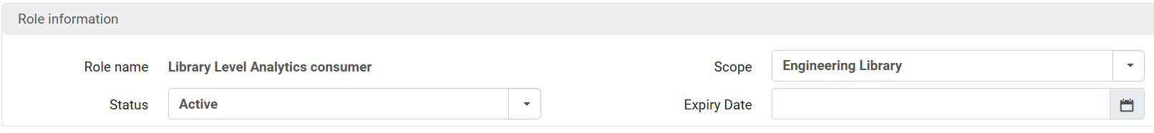
The staff user role
If a user were to have the "Library Level Analytics consumer" role as follows, then he or she would be able to view only the Engineering library in a report which contains the special filter.

Slide 11
The sample users

Slide 12
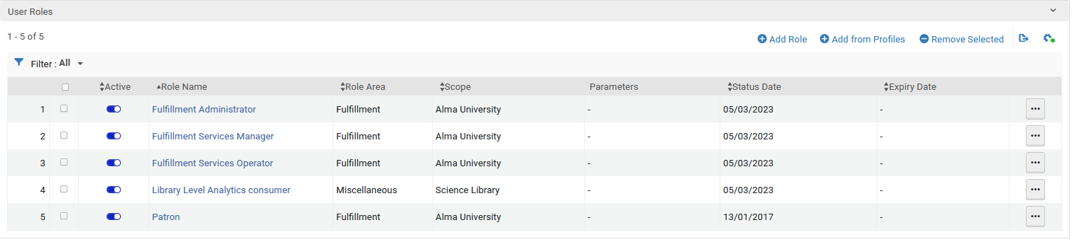
The sample users
User Suzan Aarons is permitted to see entities in the "Science Library"

Slide 13

The sample users
User Aaron Hacohen is permitted to see entities in the "Art Library"

Slide 14
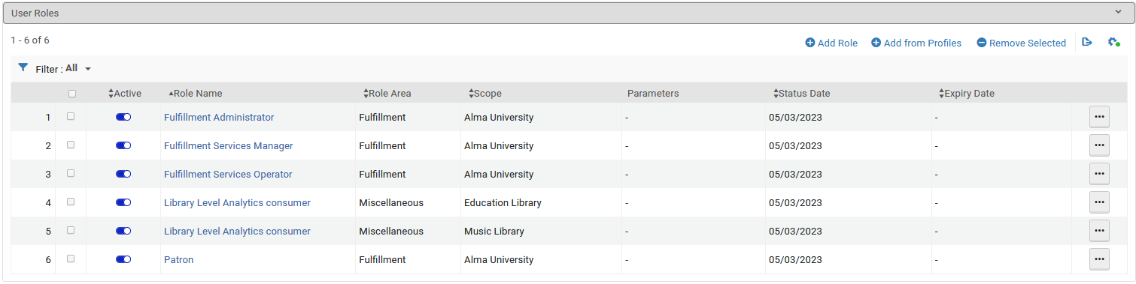
The sample users
User Tim Ashton is permitted to see entities in the "Education Library" and "Music Library"

Slide 15
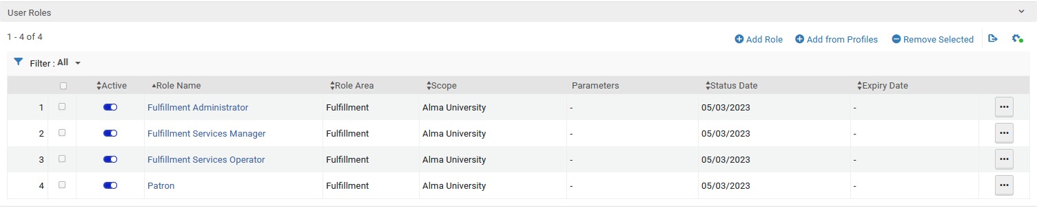
The sample users
User Caroline Devue is permitted to see entities in all libraries because she does not have the role "Library Level Analytics consumer"

Slide 16
The sample users
Summary of users:
  User Suzan Aarons is permitted to see entities in the "Science Library"
  User Aaron Hacohen is permitted to see entities in the "Art Library"
  User Tim Ashton is permitted to see entities in the "Education Library" and "Music Library"
  User Caroline Devue is permitted to see entities in all libraries

Slide 17
The library-specific filter and the sample analytics report

Slide 18

The library-specific filter and the sample analytics report
Let's take a look at analytics report "Loans with Library Name and loan date" as seen in the "results" tab after the "Analytics Designer" clicks "edit".

Slide 19
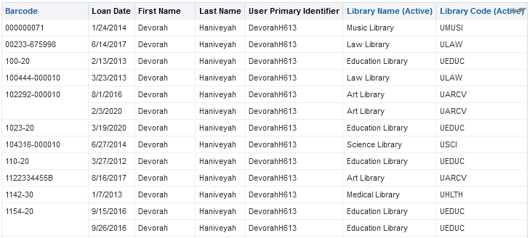
The library-specific filter and the sample analytics report
Note that we have the following libraries: Science Library, Education Library, Music Library, Art Library, Law Library, and Medical Library

Slide 20
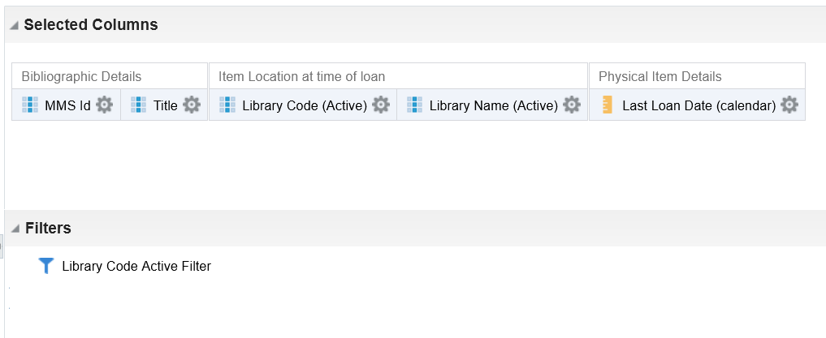
The library-specific filter and the sample analytics report
Here is the "Criteria" tab of the report
This is the new filter which enables the consumer to see only libraries which are defined as a scope in the role "Library Level Analytics consumer"

Slide 21
The library-specific filter and the sample analytics report
For each subject area in Alma Analytics there is a specific filter which limits which libraries the analytics consumer can see based on his or her scope of the role "Library Level Analytics consumer".
For the Fulfillment subject area, the filter is at "Alma > Subject Area Contents > Fulfillment" and is accessible in the left pane of the "Criteria" tab in the "Catalog" section.

Slide 22
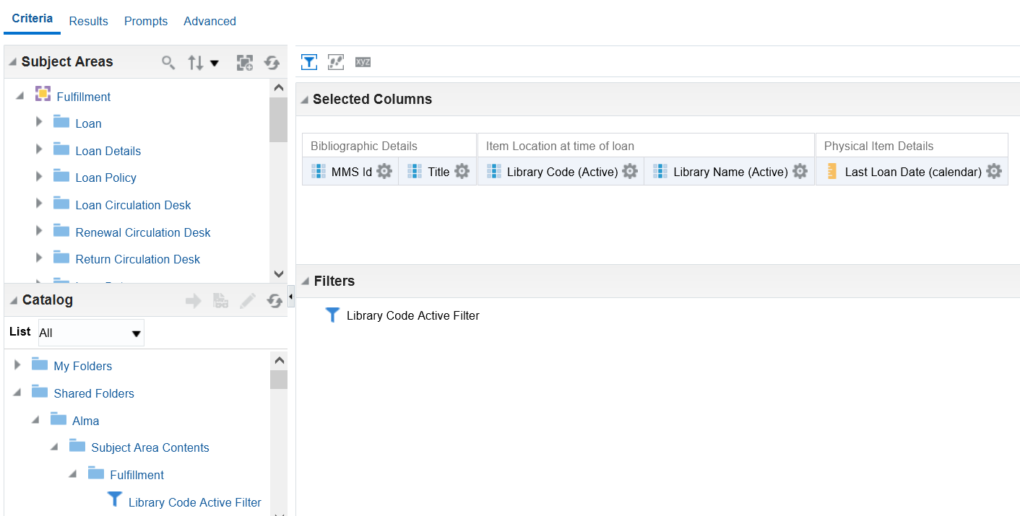
The library-specific filter and the sample analytics report
To add the filter double click and then click OK

Slide 23
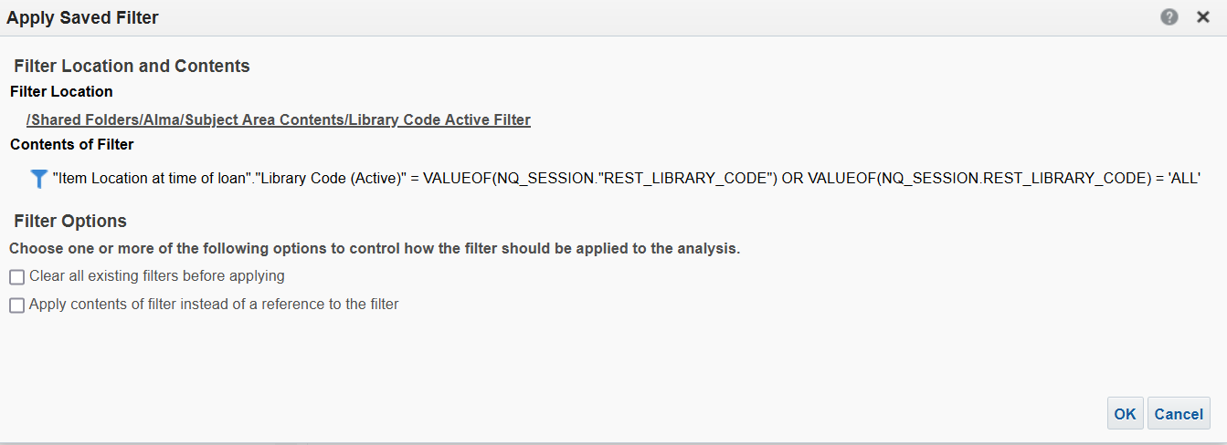
The library-specific filter and the sample analytics report
After double clicking the filter, the following message appears and then click "OK" and it will be added to the report as a filter

Slide 24
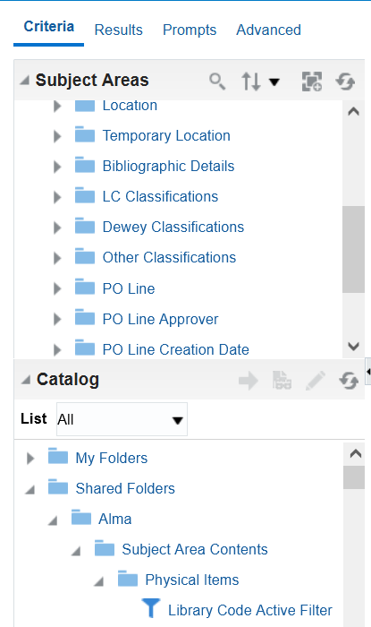
The library-specific filter and the sample analytics report
Note that we added the filter from "Alma > Subject Area Contents > Fulfillment" because the analytics report was in the Fulfillment subject area.
If the analytics report was in the Physical Items subject area, then we would have added the filter from "Alma > Subject Area Contents > Physical Items"
This is for a report in the Physical Items subject area

Slide 25
Seeing the library-specific filter functionality live

Slide 26
Seeing the library-specific filter functionality live
Each of our four sample users has a " Pinned Object" for the report we just looked at "Loans with Library Name and loan date".
How each user adds his or her "Pinned Object" is beyond the scope of this presentation.
We will focus on what the user sees after opening the report via his or her "Pinned Objects" link.

Slide 27
Seeing the library-specific filter functionality live
We already stated in the "Sample Users" section that this is the summary of users based on their scope(s) in their role(s) "Library Level Analytics consumer" (except for Caroline Devue who does not have the role at all) :
  User Suzan Aarons is permitted to see entities in the "Science Library"
  User Aaron Hacohen is permitted to see entities in the "Art Library"
  User Tim Ashton is permitted to see entities in the "Education Library" and "Music Library"
  User Caroline Devue is permitted to see entities in all libraries

Slide 28
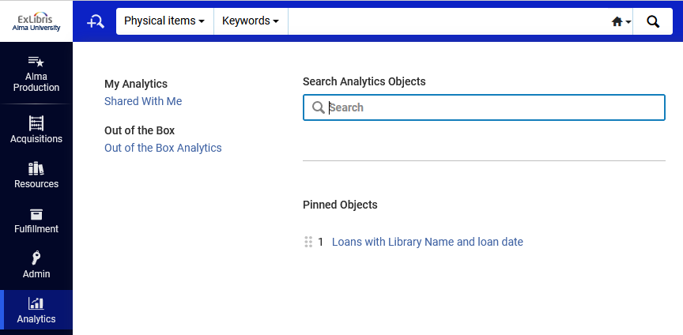
Seeing the library-specific filter functionality live
Each user will access the report from his or her list of pinned objects:

Slide 29
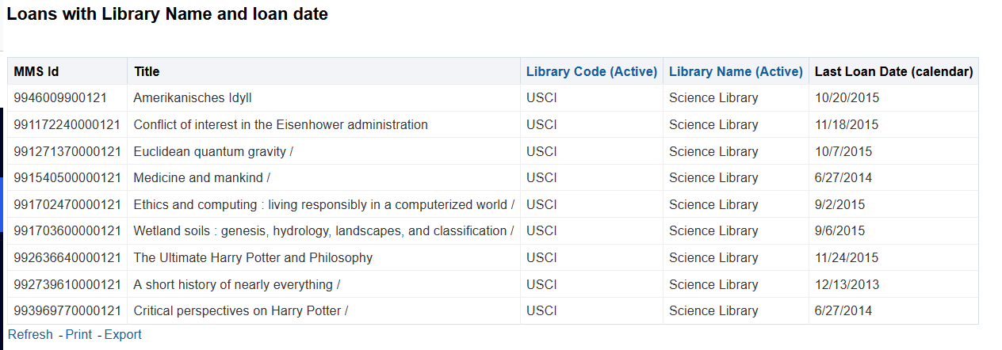
Seeing the library-specific filter functionality live
Suzan Aarons sees only the "Science Library"

Slide 30
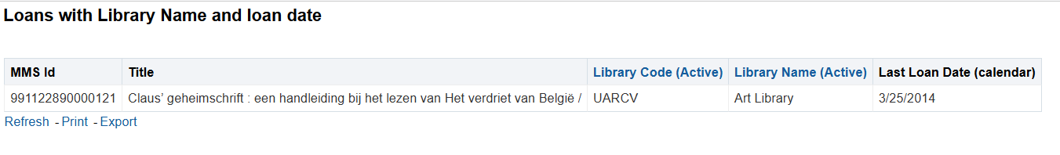
Seeing the library-specific filter functionality live
Aaron Hacohen sees only the "Art Library"

Slide 31
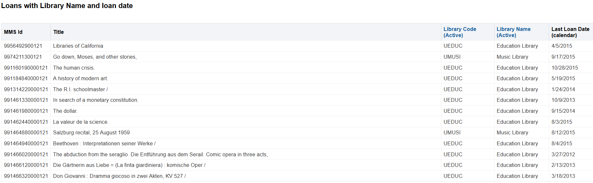
Seeing the library-specific filter functionality live
Tim Ashton sees only the "Education Library" and "Music Library"

Slide 32
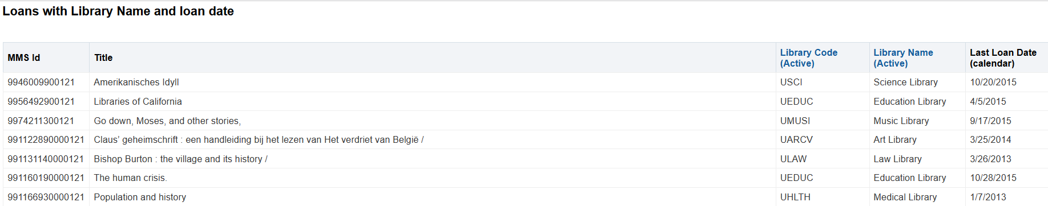
Seeing the library-specific filter functionality live
Caroline Devue sees all libraries

Slide 33
Adding the library-specific filter for the prompt

Slide 34
Adding the library-specific filter for the prompt
If we have a report with the library-specific filter (as in the example we previously made) then:
  If we add a prompt by library name to the report, and we do not add the library-specific filter to the prompt, then the analytics consumer will be able to choose any library in the prompt but he or she will only see libraries defined in his or her role "Library Level Analytics consumer"
  If we add a prompt by library name to the report, and we do add the library-specific filter to the prompt, then the analytics consumer will be able to choose only the library or libraries defined in his or her role "Library Level Analytics consumer"

Slide 35
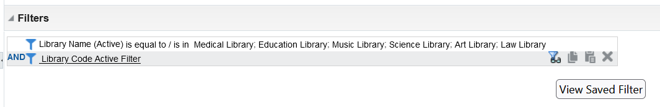
Adding the library-specific filter for the prompt
Before we begin, we will copy to the clipboard (or to a document "on the side") text from the library-specific filter.
First view the library-specific filter from the criteria tab
Click here to view the filter

Slide 36
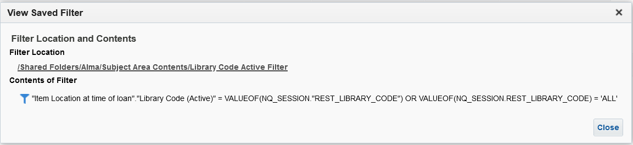
Adding the library-specific filter for the prompt
Copy the text below from the filter and close the filter

Slide 37
Adding the library-specific filter for the prompt
We will now add a prompt and add to it the library-specific filter.
Add a prompt as it would normally be added and then edit the prompt.
Click the triangle next to "Options" to open the "Options" section
In the field "Choice List Values" select "SQL Results"

Slide 38
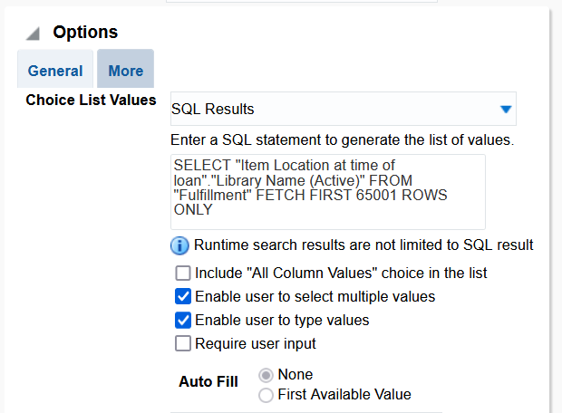
Adding the library-specific filter for the prompt
Soon we will change this default text of the SQL statement

Slide 39
Adding the library-specific filter for the prompt
Change the SQL statement as follows:
Before the "FETCH" statement add 'WHERE' (without the quotes) and then the text which was copied from the filter

Slide 40
Adding the library-specific filter for the prompt
For example, instead of this
SELECT "Item Location at time of loan"."Library Name (Active)" FROM "Fulfillment" FETCH FIRST 65001 ROWS ONLY
We will have this
SELECT "Item Location at time of loan"."Library Name (Active)" FROM "Fulfillment" WHERE "Item Location at time of loan"."Library Code (Active)" = VALUEOF(NQ_SESSION."REST_LIBRARY_CODE") OR VALUEOF(NQ_SESSION.REST_LIBRARY_CODE) = 'ALL' FETCH FIRST 65001 ROWS ONLY

Slide 41
Seeing the library-specific filter for the prompt functionality live

Slide 42
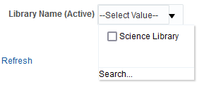
Seeing the library-specific filter for the prompt functionality live
Suzan Aarons sees only the Science Library in the prompt

Slide 43
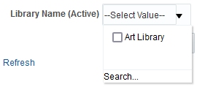
Seeing the library-specific filter for the prompt functionality live
Aaron Hacohen sees only the Art Library in the prompt

Slide 44
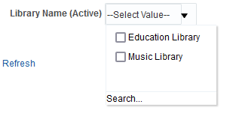
Seeing the library-specific filter for the prompt functionality live
Tim Ashton sees only the Education Library and Music Library in the prompt

Slide 45
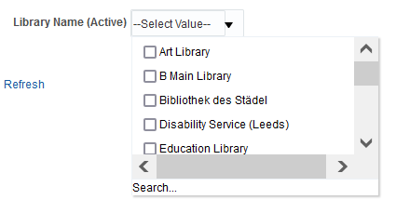
Seeing the library-specific filter for the prompt functionality live
Caroline Devue sees all libraries in the prompt

Slide 46
Statistical Categories by Library

Slide 47
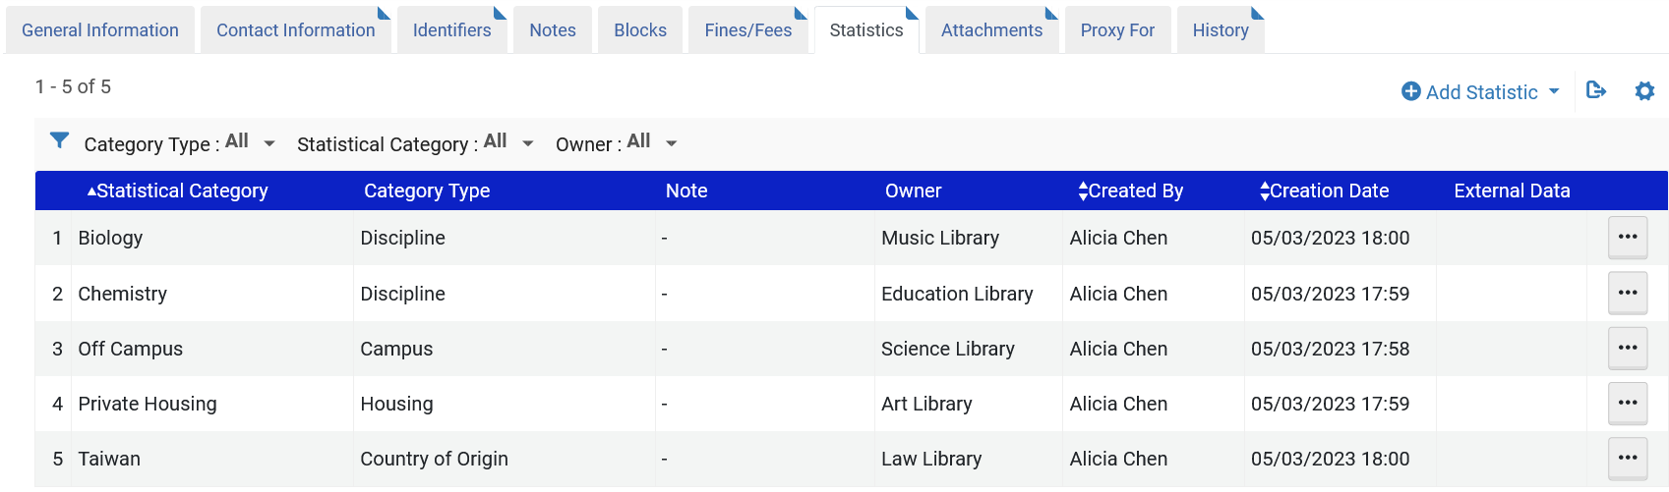
Statistical Categories by Library
Patron Anna Nemati has statistical categories in multiple libraries
Feature Flag LIBRARY_LEVEL_STATISTICS active
customer parameters limit_fulfillment_data_by_library_scope FULL

Slide 48
Statistical Categories by Library
In analytics "Users" subject area we can see these statistical categories with the library.
In the "Statistics" folder the following fields are new:
  Statistics Library Code
  Statistics Library Name
  Statistical Category type

Slide 49
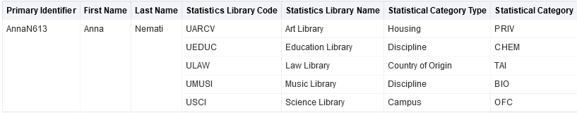
Statistical Categories by Library
Here is a sample report

Slide 50
Statistical Categories by Library
Note: The Statistical Categories 1 - 10 fields now display library level data (if available) in the following subject areas:
  Borrowing Requests
  Fines and Fees
  Fulfillment
  Requests
Where there is no matching library level value, institution level values will be used instead. The user data there can be anonymized, all other subject areas display institution level data.
The Statistical Category Types are mapped to the specified column (1 – 10) in the Analytics section of the Configuration in Alma.

Slide 51
Adding the library-specific filter for statistical categories

Slide 52
Adding the library-specific filter for statistical categories
Now we will add a filter so that each user will only see the libraries that correspond to his or her scope in the "Library Level Analytics consumer" role
This time we will not copy the filter from folder "Alma > Subject Area Contents > [Subject Area]"
Instead, we will manually create the filter.

Slide 53
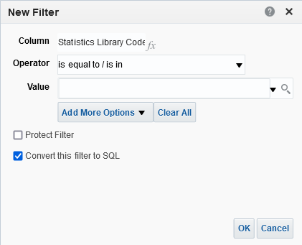
Adding the library-specific filter for statistical categories
To add a filter on the Statistics value, create a new filter on the Statistics Library Code filter, and check 'Convert this filter to SQL' and then click OK.

Slide 54
Adding the library-specific filter for statistical categories
After the = sign Append the following text to the filter and click OK.
VALUEOF(NQ_SESSION."REST_LIBRARY_CODE") OR VALUEOF(NQ_SESSION.REST_LIBRARY_CODE) = 'ALL'

Slide 55
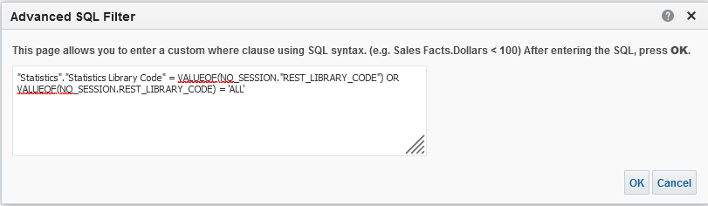
Adding the library-specific filter for statistical categories

Slide 56
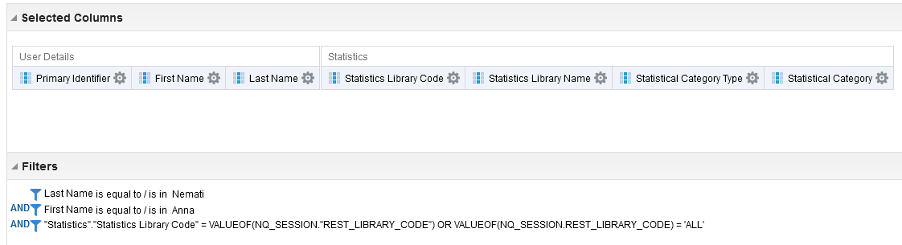
Adding the library-specific filter for statistical categories
The library-specific filter has been added.

Slide 57
Adding the library-specific filter for statistical categories
The filter for restricted libraries will be applied to the report on the Statistical Categories libraries.
This method can be used in Block and Notes folders as well.

Slide 58
Seeing the library-specific filter for statistical categories functionality live

Slide 59
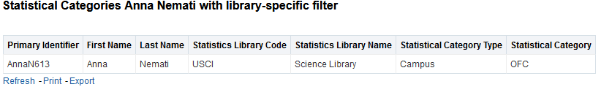
Seeing the library-specific filter for statistical categories functionality live
Susan Aarons sees only the Science Library

Slide 60
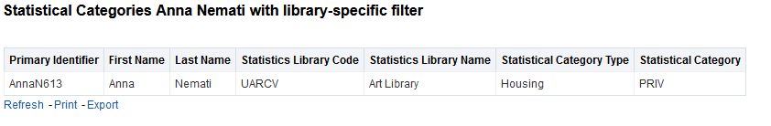
Seeing the library-specific filter for statistical categories functionality live
Aaron Hacohen sees only the Art Library

Slide 61
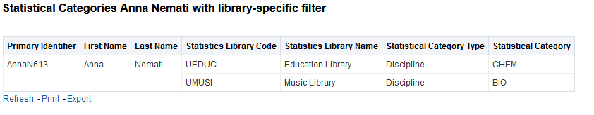
Seeing the library-specific filter for statistical categories functionality live
Tim Ashton sees only the Education Library and Music Library

Slide 62
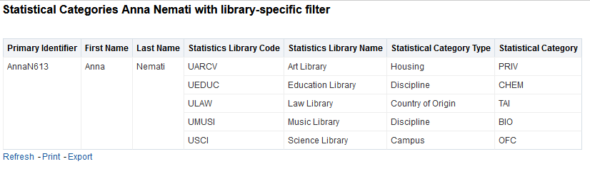
Seeing the library-specific filter for statistical categories functionality live
Caroline Devue sees all libraries

Slide 63
Regarding other subject areas

Slide 64
Regarding other subject areas
The filter is always named "Library Code Active Filter".
The following table (on next slide) shows the subject areas that have the filter available, with the filter applied to the field.

Slide 65
Regarding other subject areas
Subject Area | Field for filter
Borrowing Requests (Resource Sharing) | Library Unit.Library Code (Active)
DARA | Library Unit.Library Code (Active)
Digital Inventory | Representation Library Unit.Library Code (Active)
Digital Waitlist | Library Unit.Library Code (Active)
E-Inventory | Porfolio Library Unit.Library Code (Active)
Fines and Fees | Owning Library.Owning Library Code (Active)
Fulfillment | Item Location at time of loan.Library Code (Active)
Funds Expenditure | Library Unit.Library Code (Active)
Lending Requests (Resource Sharing) | Library Unit.Library Code (Active)
Licenses | License Library Unit.Library Code (Active)
Physical Items | Library Unit.Library Code (Active)
Purchase Requests | Library Unit.Library Code (Active)
Requests | Owning Library.Owning Library Code (Active)

Slide 66
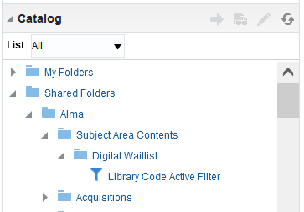
Regarding other subject areas
This is, for example, from the "Digital Waitlist" subject area

Slide 67
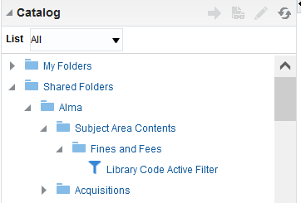
Regarding other subject areas
This is, for example, from the "Fines and Fees" subject area

Slide 68
The DV workbook

Slide 69
The DV workbook
Here are the steps to add the filter to the DV workbook so that the "Library Level Analytics consumer" role will take effect:
Create the DV workbook as you would any other workbook
Save or Close the workbook and go to the "catalog".
Navigate to "Shared Folders > Alma > Subject Area Contents" and then to the folder with the name of the subject area of the DV workbook.
Open the sample workbook "{name of subject area}DV Template - Library Filter"
Copy the filter which appears on top
Open the DV workbook to which we want to add the filter and add an expression filter.
Paste the filter which we copied into the expression filter.
Save the workbook

Slide 70
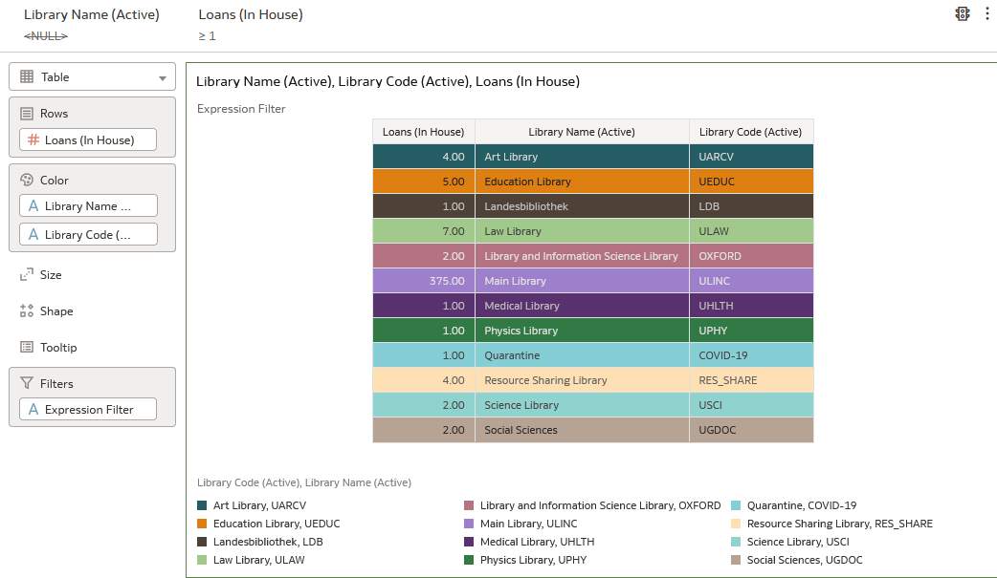
The DV workbook
Create the DV workbook as you would any other workbook
This is created in the Fulfillment subject area and includes the "# Loans (In House)", the "Library Name (Active)" and the "Library Code (Active)".
It filters by "Library Name (Active)" is not NULL and "# Loans (In House)" >= 1

Slide 71
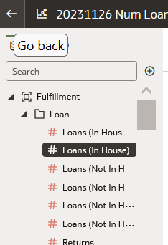
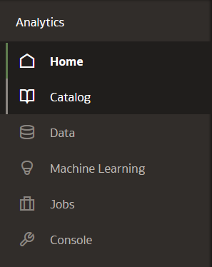
The DV workbook
Save or Close the workbook and go to the "catalog".

Slide 72
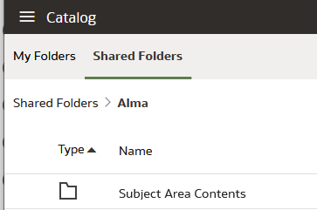
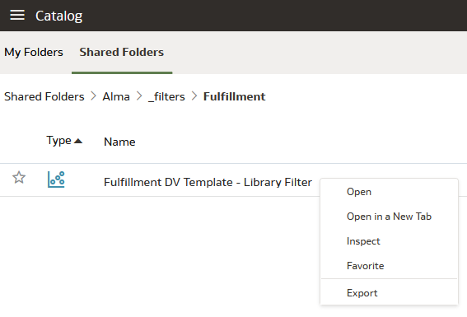
The DV workbook
Navigate to "Shared Folders > Alma > Subject Area Contents" and then to the folder with the name of the subject area of the DV workbook.
Open the sample workbook "{name of subject area}DV Template - Library Filter"

Slide 73
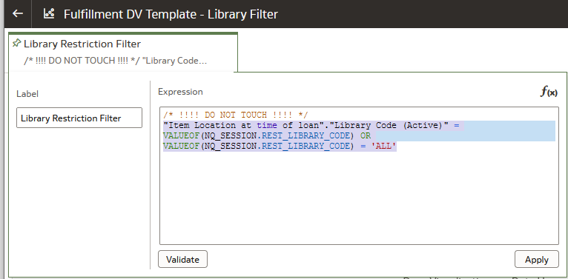
The DV workbook
Copy the filter which appears on top

Slide 74
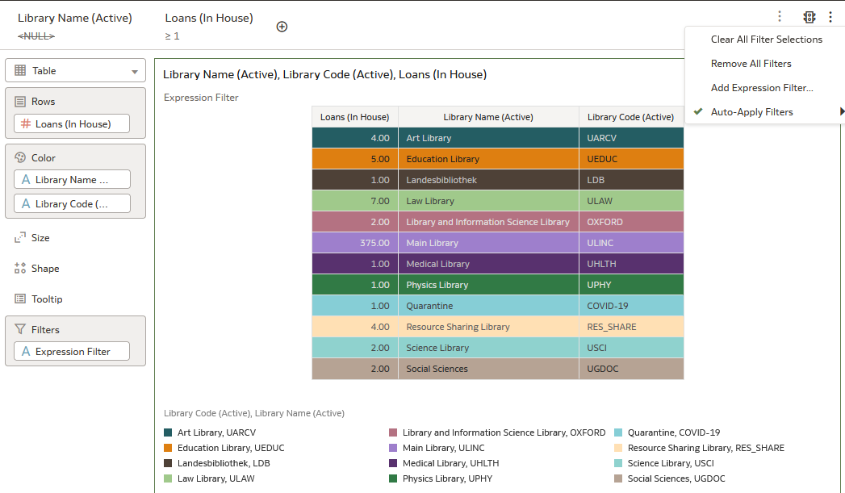
The DV workbook
Open the DV workbook to which we want to add the filter and add an expression filter.
Hover mouse here until you see the three dots

Slide 75
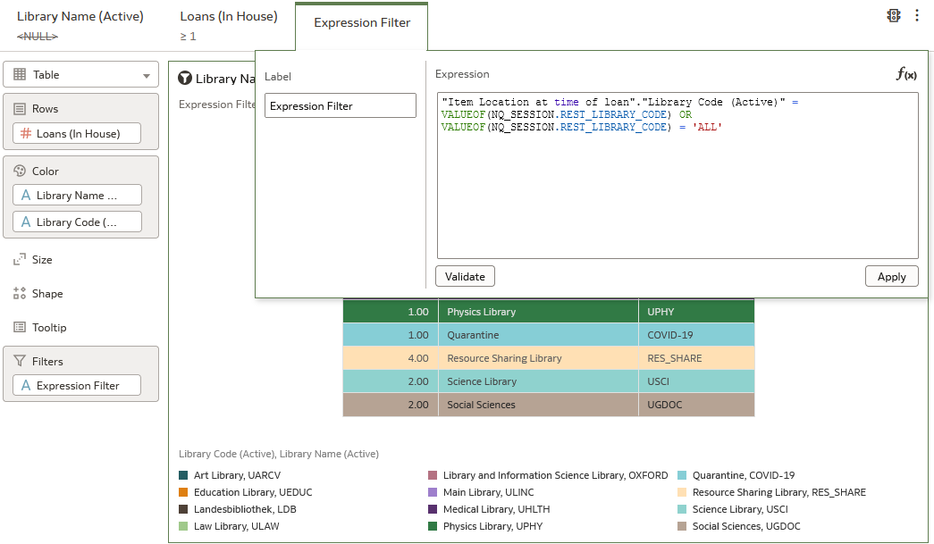
The DV workbook
Paste the filter which we copied into the expression filter.
Click "Apply" when done

Slide 76
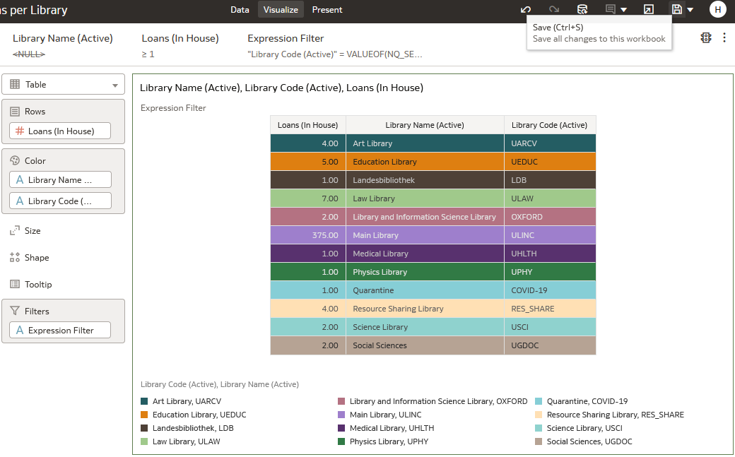
The DV workbook
This is the filter we added to filter by scope of role "Library Level Analytics consumer"
Save the workbook

Slide 77
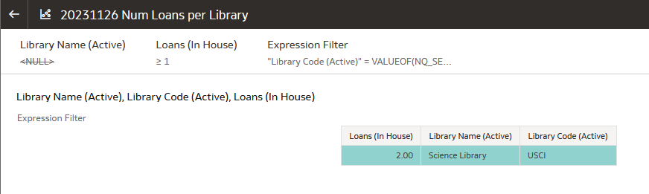
The DV workbook
Suzan Aarons sees only the "Science Library"

Slide 78
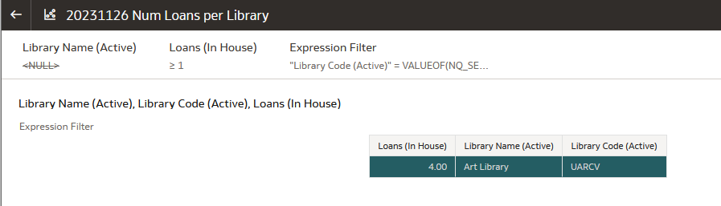
The DV workbook
Aaron Hacohen sees only the "Art Library"

Slide 79
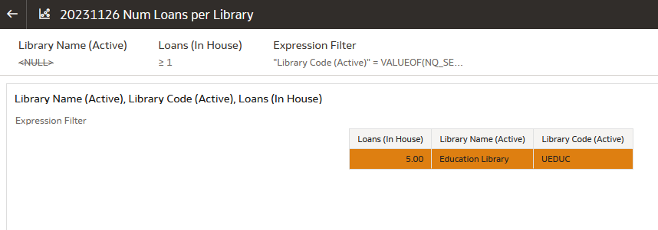
The DV workbook
Tim Ashton sees only the "Education Library" (he would also see the "Music Library" if there were loans, but no loans for the "Music Library" appear in the results).

Slide 80
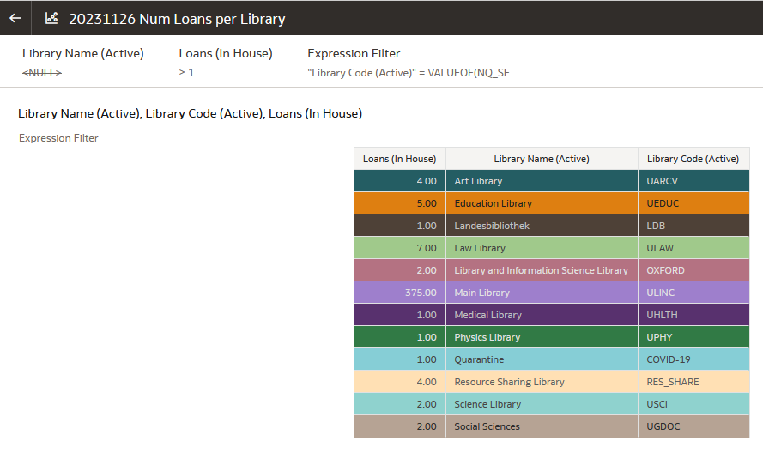
The DV workbook
Caroline Devue sees all libraries

